Slide 1
Page Replacement Algorithms
The Art of Memory Management
Presented by:
Sandesh Shrestha 2K21/CO/417
Sanskar Ojha 2K21/CO/418

Slide 2
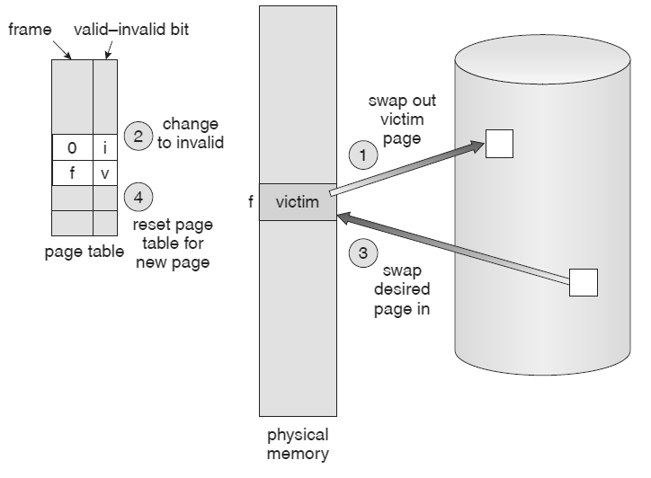
Page Replacement Algorithms
Lower Page-fault Rate
determines which pages should be removed from memory when there is no more space available in main memory for new pages.

Slide 3
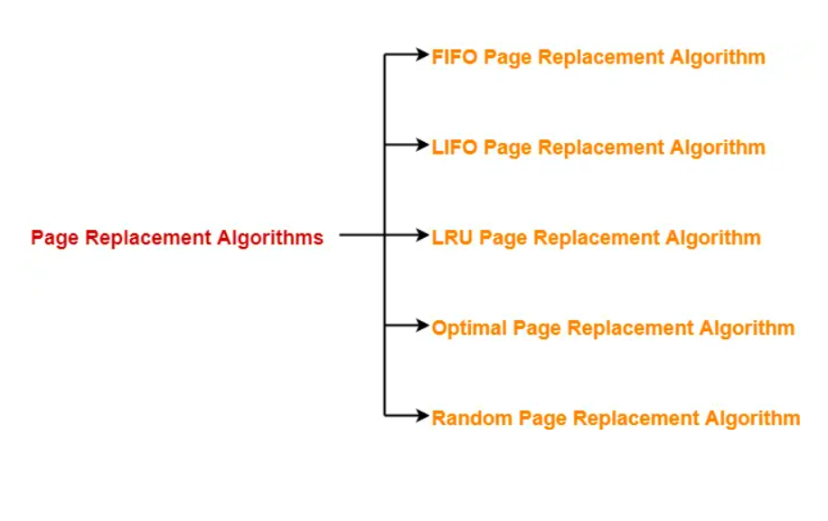
Page Replacement Algorithms

Slide 4
Page Replacement Algorithms
FIFO (First In First Out): the page that has been in memory the longest is replaced first.
LRU (Least Recently Used): the page that has not been accessed for the longest time is replaced first.
Optimal Page Replacement: replaces the page that will not be used for the longest time in the future.

Slide 5
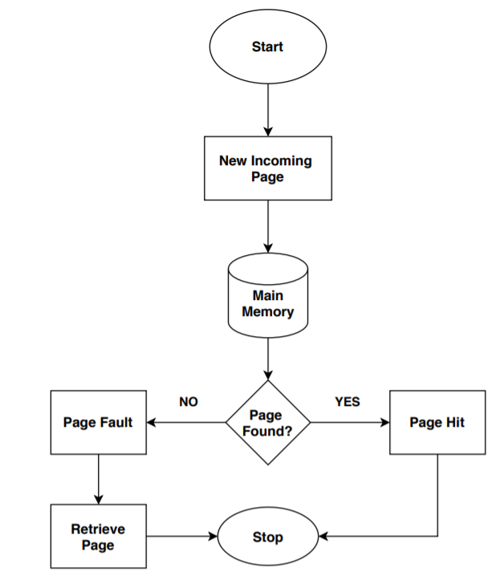

FIFO Page Replacement Algorithm
FIFO algorithm replaces the oldest (First) page which has been present for the longest time in the main memory.
In simple words, When a new page comes in from secondary memory to main memory, It selects the front of the queue which is the oldest page present, and replaces it with a new page.
Run page fault
service routine

Slide 6
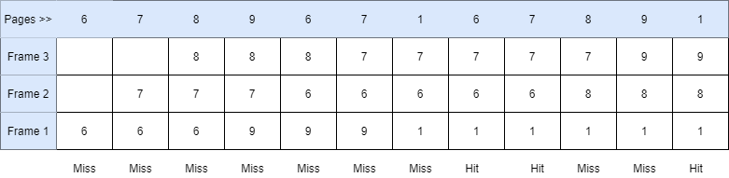
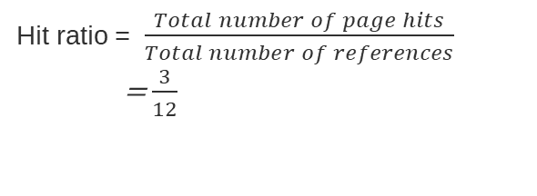
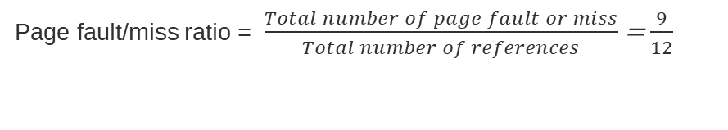
A system uses 3 page frames for storing process pages in main memory. It uses the First in First out (FIFO) page replacement policy. Assume that all the page frames are initially empty. What is the total number of page faults that will occur while processing the page reference string given - 6, 7, 8, 9, 6, 7, 1, 6, 7, 8, 9, 1. Also calculate the hit ratio and miss ratio.
Hit ratio = $\frac{Total number of page hits}{Total number of references}$
= $\frac{3}{12}$
Page fault/miss ratio = $\frac{Total number of page fault or miss}{Total number of references}$ = $\frac{9}{12}$

Slide 7
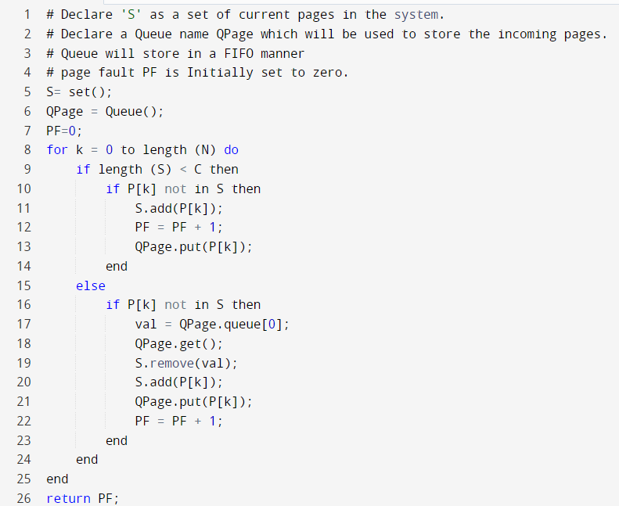
FIFO Page Replacement Algorithm

Slide 8
Advantages of FIFO Page Replacement Algorithm
commonly known for its simplicity.
much easy to implement as well as understand.
Small systems can use the FIFO algorithm efficiently.
Disadvantages of FIFO Page Replacement Algorithm
Uses an additional Queue data structure.
It suffers from Belady's anomaly problem i.e when the number of page frames increases, more memory is given to processes, but instead of decreasing, the number of page faults increases.

Slide 9
Belady’s anomaly
For LRU and optimal page replacement algorithms, increasing the number of frames generally reduces the number of page faults.
However, Belady found that , for the FIFO page replacement algorithm, increasing the number of frames can actually increases the number of page faults.

Slide 10
Belady’s anomaly
Reference String : 0 1 5 3 0 1 4 0 1 5 3 4.
Case 1: Number of frames = 3
Request | 0 | 1 | 5 | 3 | 0 | 1 | 4 | 0 | 1 | 5 | 3 | 4
Frame 3 |  |  | 5 | 5 | 5 | 1 | 1 | 1 | 1 | 1 | 3 | 3
Frame 2 |  | 1 | 1 | 1 | 0 | 0 | 0 | 0 | 0 | 5 | 5 | 5
Frame 1 | 0 | 0 | 0 | 3 | 3 | 3 | 4 | 4 | 4 | 4 | 4 | 4
Miss/Hit | Miss | Miss | Miss | Miss | Miss | Miss | Miss | Hit | Hit | Miss | Miss | Hit
Number of Page Faults = 9
Page miss ratio = 9/12

Slide 11
Belady’s anomaly
Reference String : 0 1 5 3 0 1 4 0 1 5 3 4.
Case 2: Number of frames = 4
Request | 0 | 1 | 5 | 3 | 0 | 1 | 4 | 0 | 1 | 5 | 3 | 4
Frame 4 |  |  |  | 3 | 3 | 3 | 3 | 3 | 3 | 5 | 5 | 5
Frame 3 |  |  | 5 | 5 | 5 | 5 | 5 | 5 | 1 | 1 | 1 | 1
Frame 2 |  | 1 | 1 | 1 | 1 | 1 | 1 | 0 | 0 | 0 | 0 | 4
Frame 1 | 0 | 0 | 0 | 0 | 0 | 0 | 4 | 4 | 4 | 4 | 3 | 3
Miss/Hit | Miss | Miss | Miss | Miss | Hit | Hit | Miss | Miss | Miss | Miss | Miss | Miss
Number of Page Faults = 10
Page miss ratio = 10/12

Slide 12
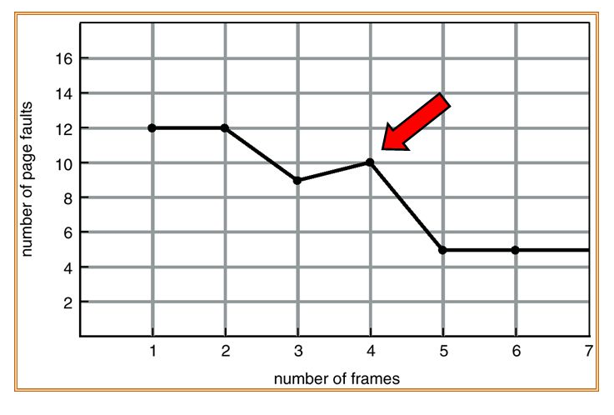
Belady’s anomaly
increasing the number of page frames in a memory can sometimes lead to an increase in the number of page faults in a FIFO page replacement algorithm.

Slide 13
LRU Page Replacement Algorithm
LRU stands for Least Recently Used.
based on the strategy that whenever a page fault occurs, the least recently used page will be replaced with a new page. So, the page not utilized for the longest time in the memory (compared to all other pages) gets replaced.
This algorithm works on previous data. The page which is used the earliest is replaced or which appears the earliest in the sequence is replaced.

Slide 14
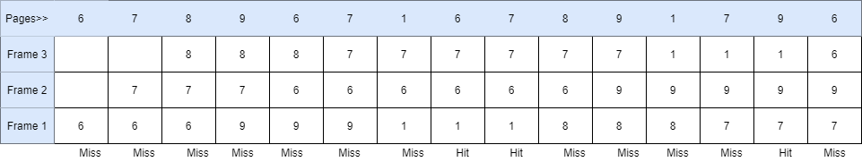
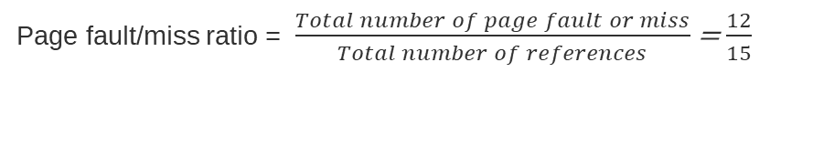
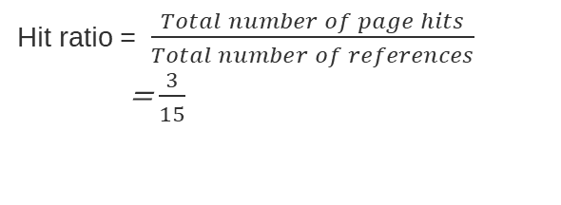
A system uses 3 page frames for storing process pages in main memory. It uses the LRU page replacement policy. Assume that all the page frames are initially empty. What is the total number of page faults that will occur while processing the page reference string given - 6, 7, 8, 9, 6, 7, 1, 6, 7, 8, 9, 1, 7, 9, 6. Also calculate the hit ratio and miss ratio.
Hit ratio = $\frac{Total number of page hits}{Total number of references}$
= $\frac{3}{15}$
Page fault/miss ratio = $\frac{Total number of page fault or miss}{Total number of references}$ = $\frac{12}{15}$

Slide 15
Advantages of LRU Page Replacement Algorithm
Performs well in many scenarios, particularly when there is a high degree of locality in the memory access pattern.
Can work well with large numbers of pages in memory.
Disadvantages of LRU Page Replacement Algorithm
Requires tracking every memory access to determine which page is least recently used, which can be computationally expensive.
May require specialized hardware support to implement efficiently.

Slide 16
MRU Page Replacement Algorithm
MRU stands for Most Recently Used.
selects the page that was most recently accessed for replacement when a page fault occurs, rather than the least recently used page as in the LRU algorithm..
To implement the MRU algorithm, the page table keeps track of the timestamp of the last access for each page in memory.

Slide 17
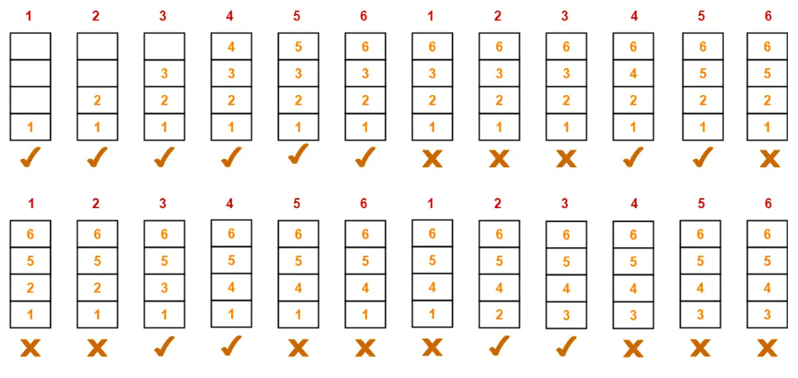
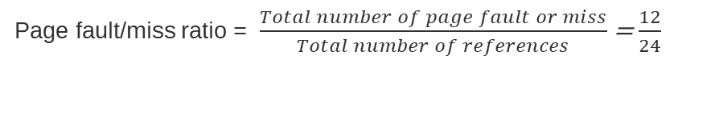
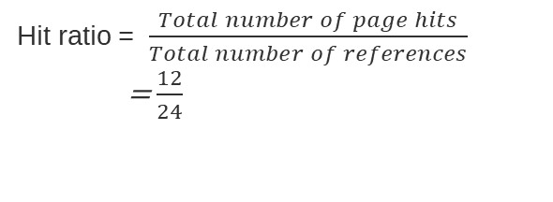
A system uses 3 page frames for storing process pages in main memory. It uses the LRU page replacement policy. Assume that all the page frames are initially empty. What is the total number of page faults that will occur while processing the page reference string given - 1, 2, 3, 4, 5, 6, 1, 2, 3, 4, 5, 6, 1, 2, 3, 4, 5, 6, 1, 2, 3, 4, 5, 6. Also calculate the hit ratio and miss ratio.
Hit ratio = $\frac{Total number of page hits}{Total number of references}$
= $\frac{12}{24}$
Page fault/miss ratio = $\frac{Total number of page fault or miss}{Total number of references}$ = $\frac{12}{24}$

Slide 18
Advantages of MRU Page Replacement Algorithm
Can perform well in situations where a small number of pages are accessed frequently and need to be kept in memory.
Disadvantages of MRU Page Replacement Algorithm
Can suffer from the same computational overhead as LRU, as it also requires tracking every memory access.
May perform poorly in scenarios where there is a low degree of locality in the memory access pattern, as it may replace pages that are likely to be needed again soon.

Slide 19
Optimal Page Replacement Algorithm
The most desirable page replacement algorithm for replacing pages.
the page which would be used after the longest interval is replaced. In other words, the page which is farthest to come in the upcoming sequence is replaced.

Slide 20
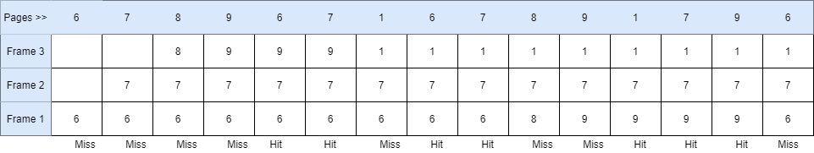


A system uses 3 page frames for storing process pages in main memory. It uses the Optimal page replacement algorithm. Assume that all the page frames are initially empty. What is the total number of page faults that will occur while processing the page reference string given - 6, 7, 8, 9, 6, 7, 1, 6, 7, 8, 9, 1, 7, 9, 6. Also calculate the hit ratio and miss ratio.
Hit ratio = $\frac{Total number of page hits}{Total number of references}$
= $\frac{7}{15}$
Page fault/miss ratio = $\frac{Total number of page fault or miss}{Total number of references}$ = $\frac{8}{15}$

Slide 21
Advantages of Optimal Page Replacement Algorithm:
Least page fault occurs as this algorithm replaces the page that is not going to be used for the longest time in the future.
Belady's Anomaly does not occur in this algorithm.
Optimal page replacement algorithm always gives the best performance in every scenario.

Slide 22
Optimal PR Algorithm: Setbacks
not practical because it cannot predict whether the page it is going to remove will not be used in the future.
Maybe it removes a page and then immediately after an iteration we will again need that removed page in a frame.

Slide 23
Important Results :
Optimal page replacement algorithm always gives the best performance in every scenario.
Result 1: For a Reference String Consisting Of Repeated Sequence Of Page Numbers, MRU page replacement algorithm will behave as Optimal page replacement algorithm.
Result 2: For a Reference String Where First Half String Is a Mirror Image Of Other Half - LRU and FIFO page replacement algorithm will behave as Optimal page replacement algorithm.

